Slide 1




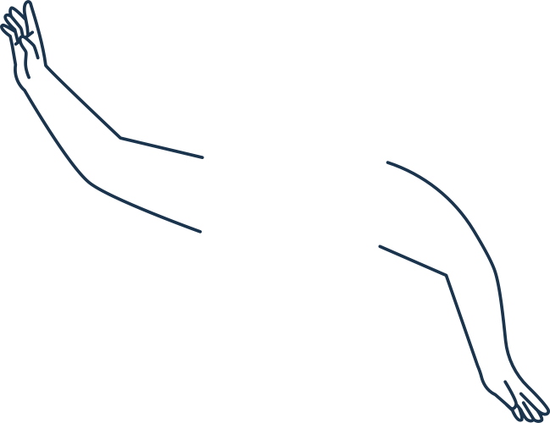


DATASTRUCTURE 2021
TELECARE
WEB APP
PROJECT

Slide 2

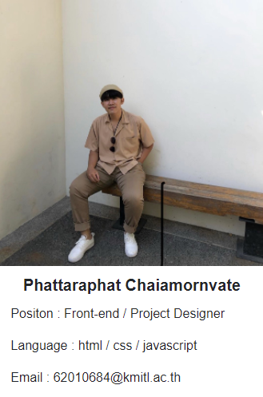





Meet the Teams

Slide 3


Index

Slide 4
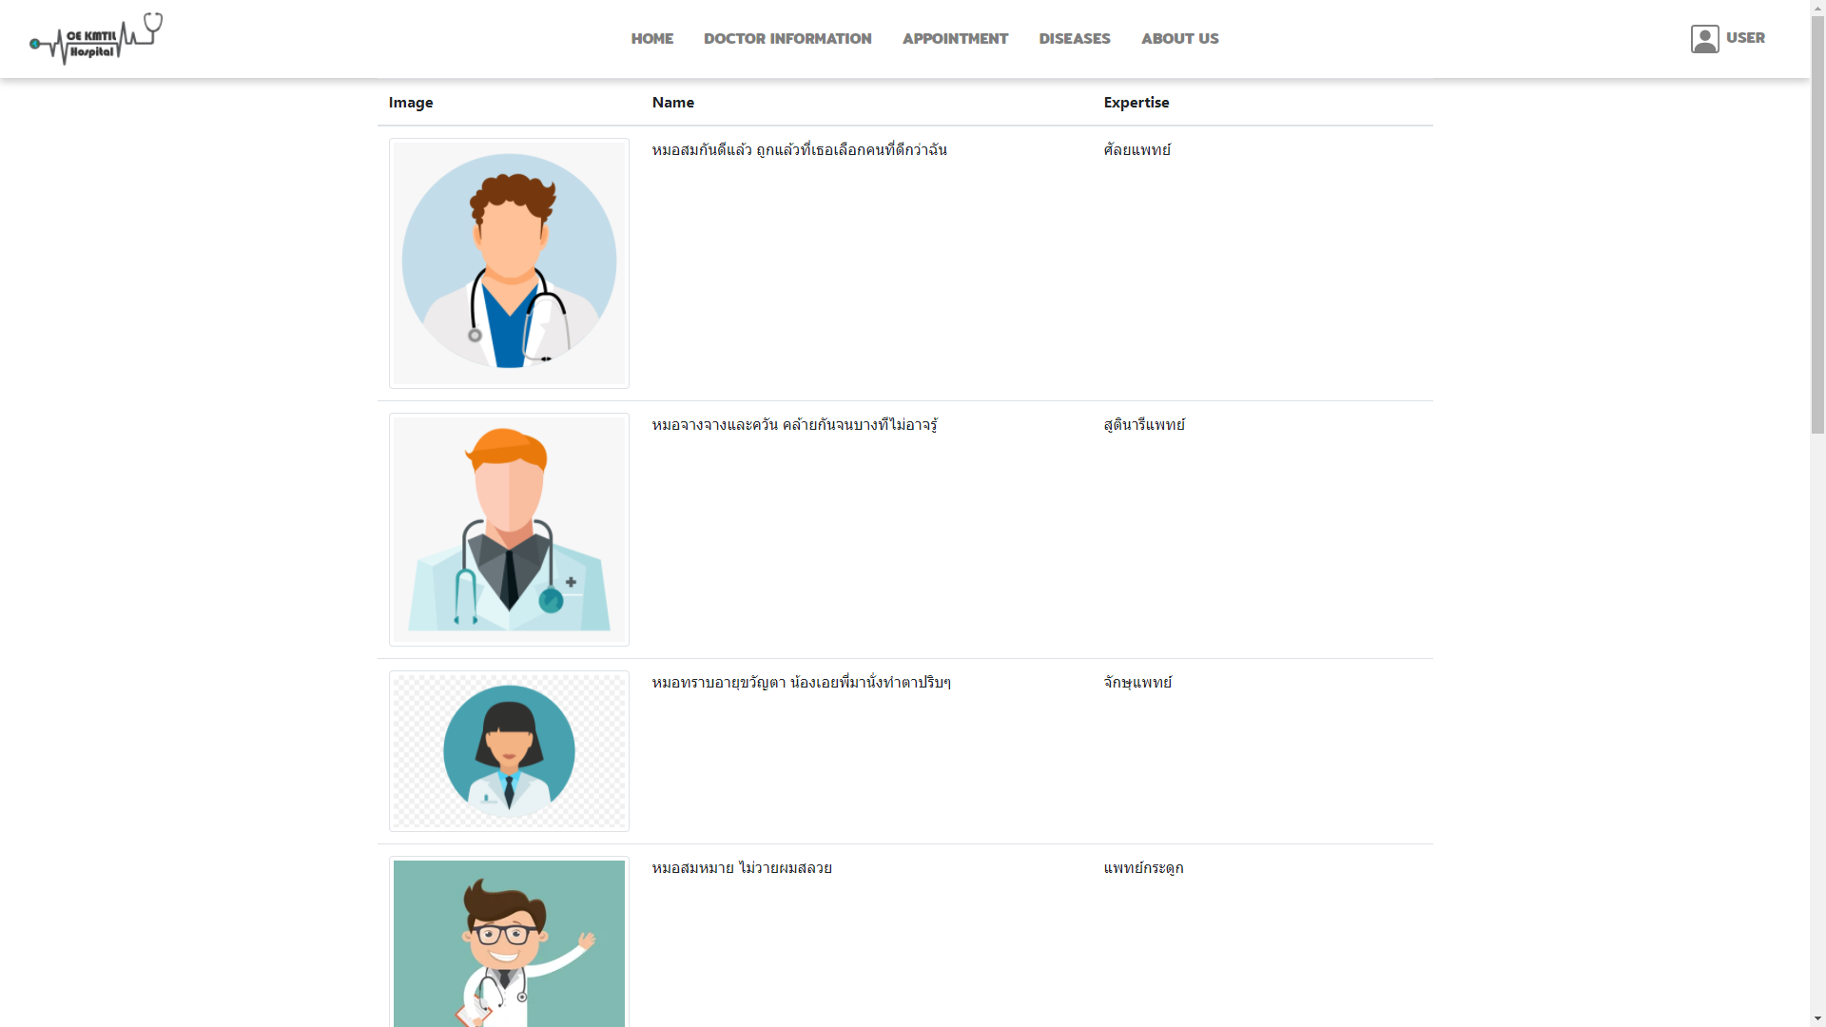
Doctor Info.

Slide 5
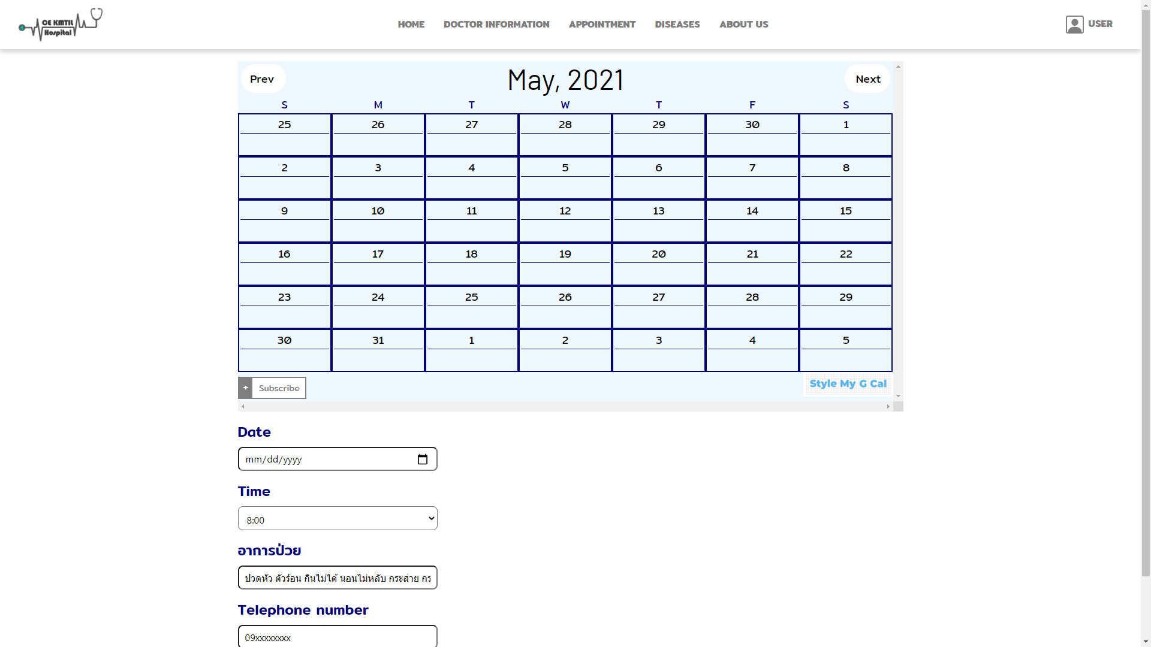
Appointment
- Queue
- Sort

Slide 6
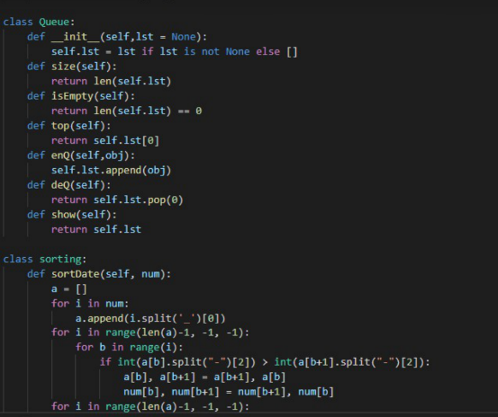

Queue &
Sort

Slide 7
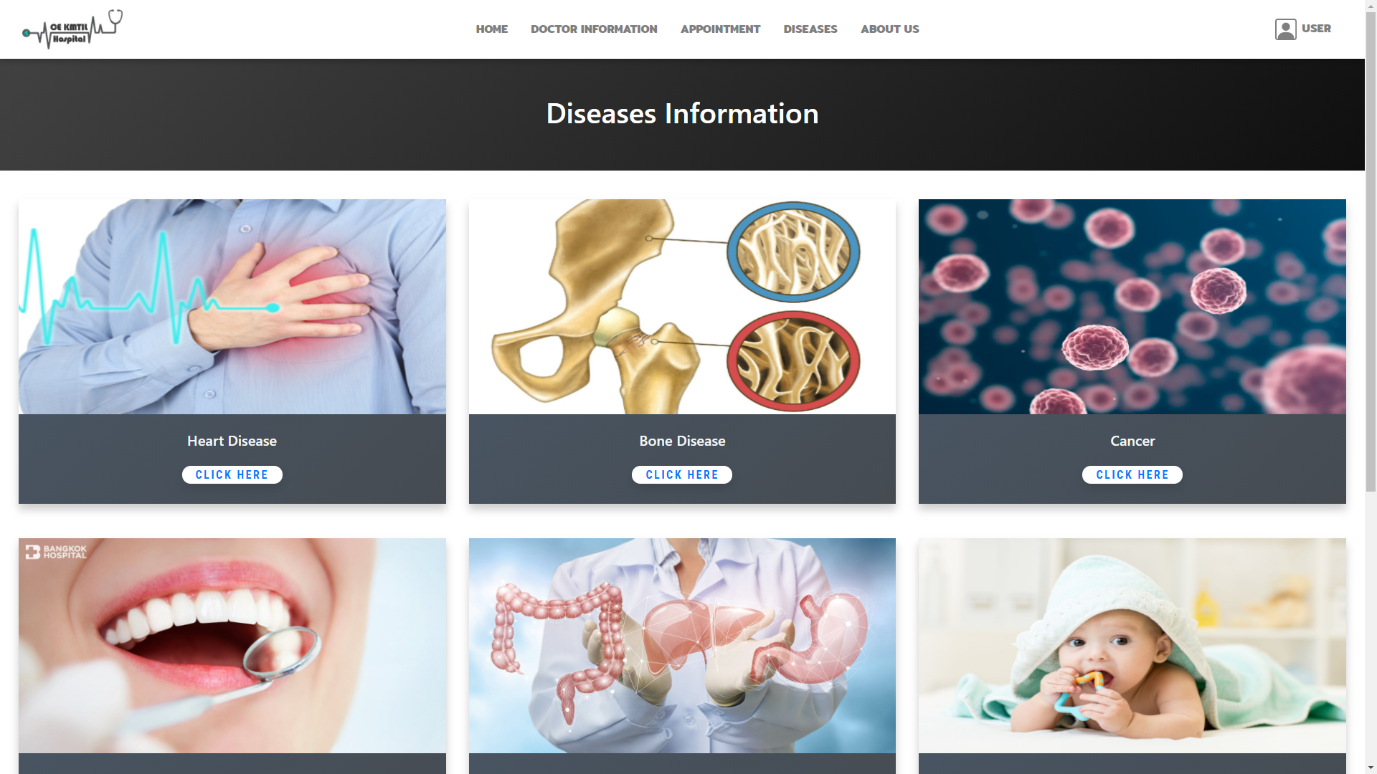
Diseases

Slide 8
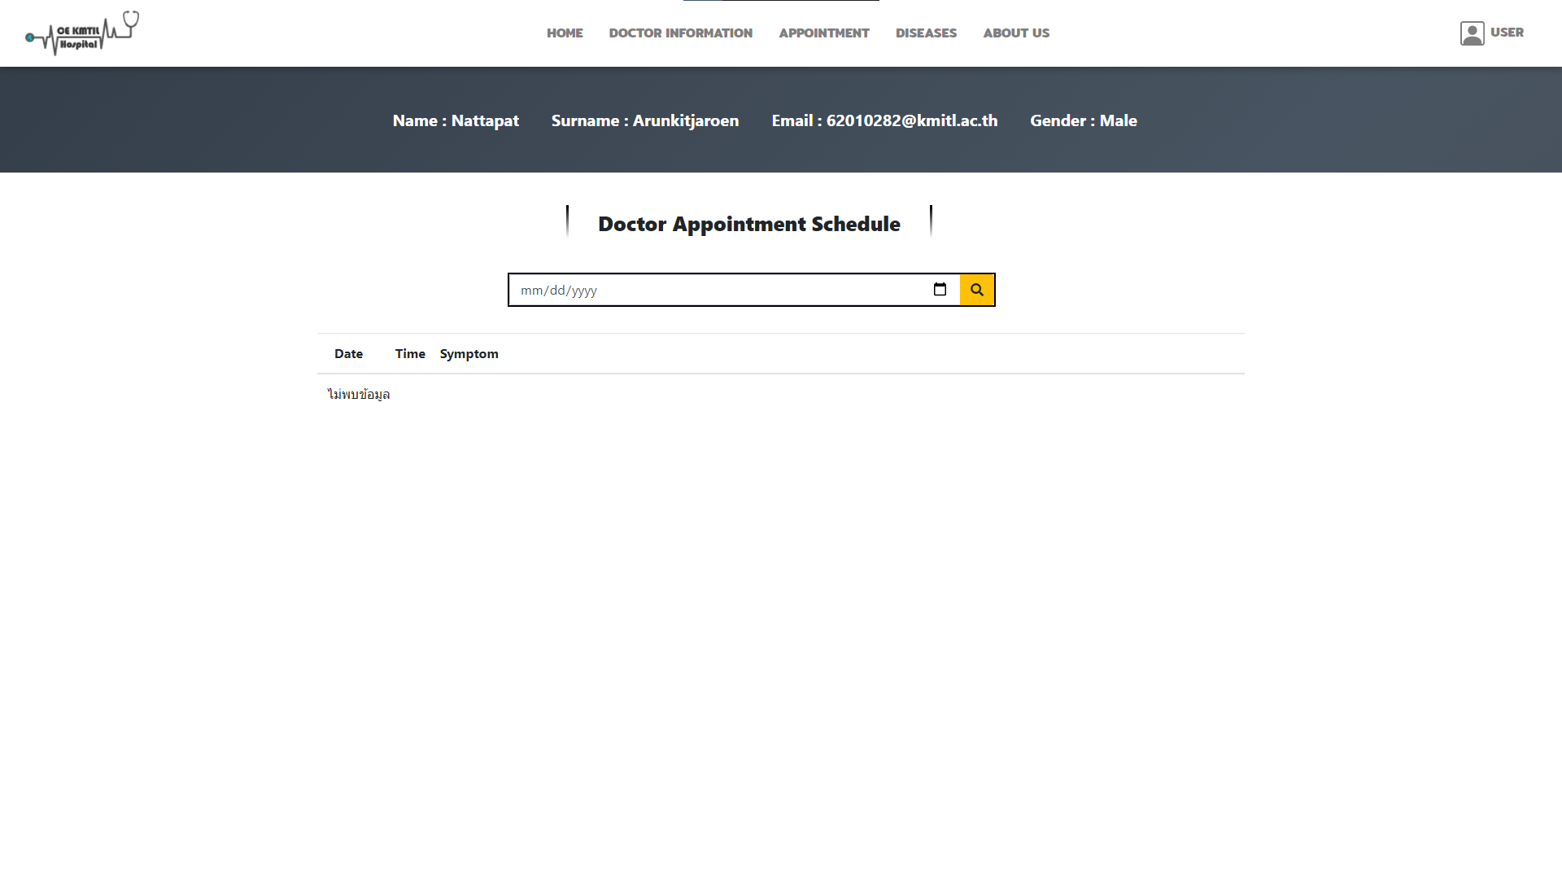
User Details
- Search
- Stack

Slide 9
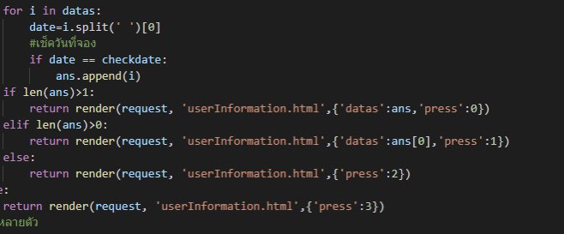
Search

Slide 10
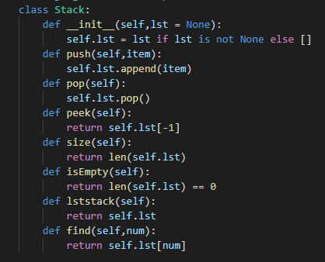
Stack

